Slide 1


Slide 2






Who’s watching?
Prof. Jessica Menezes

Slide 3
GROUP 7
Subject :- Marketing Management
Professor :- Jessica Menezes
Manish Suthar
Shreetej Gorathe
Suhas Sawant
Mohassir Khan
Mrunmayee More
Suvarna Bamne
Sanjay Patra

Slide 4

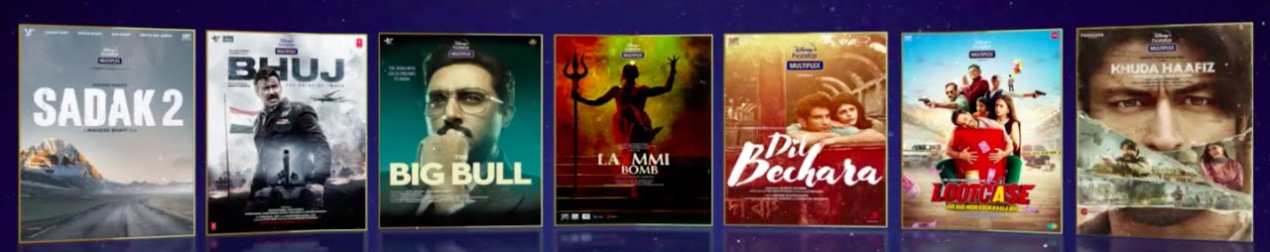
Introduction to Disney+ Hotstar
Disney+ Hotstar is a popular streaming platform that offers a wide range of content, including movies, TV shows, and live sports. It is a part of The Walt Disney Company and provides access to Disney's extensive library of content, as well as original programming and live sports events. With a user-friendly interface and various subscription options, Disney+ Hotstar has become a go-to for entertainment lovers.

Slide 5



Marketing Mix
Product :-
Movies, series, and originals from Disney, Pixar, Marvel, Star Wars, Nat Geo, and more.
Price :-
Mobile :- ₹149/3months
Mobile :- ₹449/year
Super :- ₹899/year
Premium :- ₹1499/year

Slide 6
Marketing Mix
Place :-
India, Indonesia, Malaysia, and Thailand (as Disney+ Hotstar) Singapore, Canada and the United Kingdom (as Hotstar) United States (via Hulu)
Promotion :-
Television advertising
Online advertising
Public relation
Social media marketing
Partnerships

Slide 7
Product Level
Core
Movies and shows , TV serials , Multiple Languages
Basic
Watch content at your own convenience , Watch anywhere with mobile
Expected
High quality content (HD,4k) , Offline viewing , Personalised recommendations
Augmented
Live streaming (sports broadcast , shows) , Interactive features (introduce polls , quizzes) , VR experience
Potential
Ai powered content creation , Content creation platform

Slide 8
Product Mix
Web Series | TV Shows | Animation/Cartoon | Movies | Sports
Criminal Justice | The Freelancer | The Legend Of Hanuman | Action | Cricket
Aarya | Loki | Toy Story | Horror | Hockey
The Night Manager | Taaza Khabar | The Incredibles | Romantic | Football
Dahan | She Hulk | The Lion King | Comedy | Kabaddi
Special Ops | Devo Ke Devo Mahadev

Slide 9
Product Line :- 5
Product width :- 5
Product Length :- Total no. of product in assortment /no. of line in mix
5+5+4+4+4/5
4.4
Product Depth For web Series
= 5
Product Consistency :- Quality Content , Customer Specific Content , Customer Feedback

Slide 10





Brand Association

Slide 11

Market Segmentation
Demographic
Age
Children , Teenagers , Young adults , Adults , seniors
Geographic
Region , country
Interest & Lifestyle
Animation & Family , Drama comedy , Sports
TV serials , Hollywood content
Physcographic
Behavioral
Frequency of use
Content type preference
Device usage

Slide 12
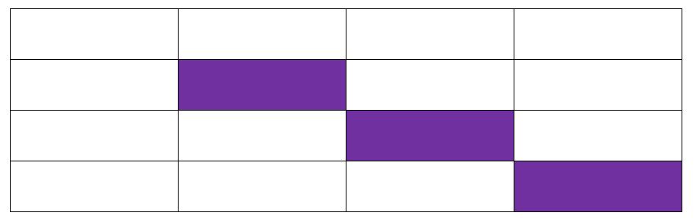
Targeting
P1
P2
P3
M1
M2
M3
SELECTIVE SPECIALIZATION

Slide 13

Positioning
Frame Of Reference(FOR) | Disney + Hot star
Nature Of Competition | Netflix , Amazon Prime , SonyLiv
Target Audience | Every one (All age group)
Point of parity | Content library , Offline viewing , UX
Point Of differentiation | Live sports , Regional content , News & Entertainment
Reason To Believe | Extensive Content Library,Trusted Brand
Deliverable | Accessible
Desirable

Slide 14
Differentiation
Content Library : | Primarily focuses on content from Disney, Pixar, Marvel, Star Wars, Net Geo
Availability | Disney is available in most countries and region around the world
Pricing | Pricing depend upon the region and chosen subscription plan also it offers FREE trial with limited content
Language support | Primarily support HINDI & ENGLISH but also support for other regional languages

Slide 15
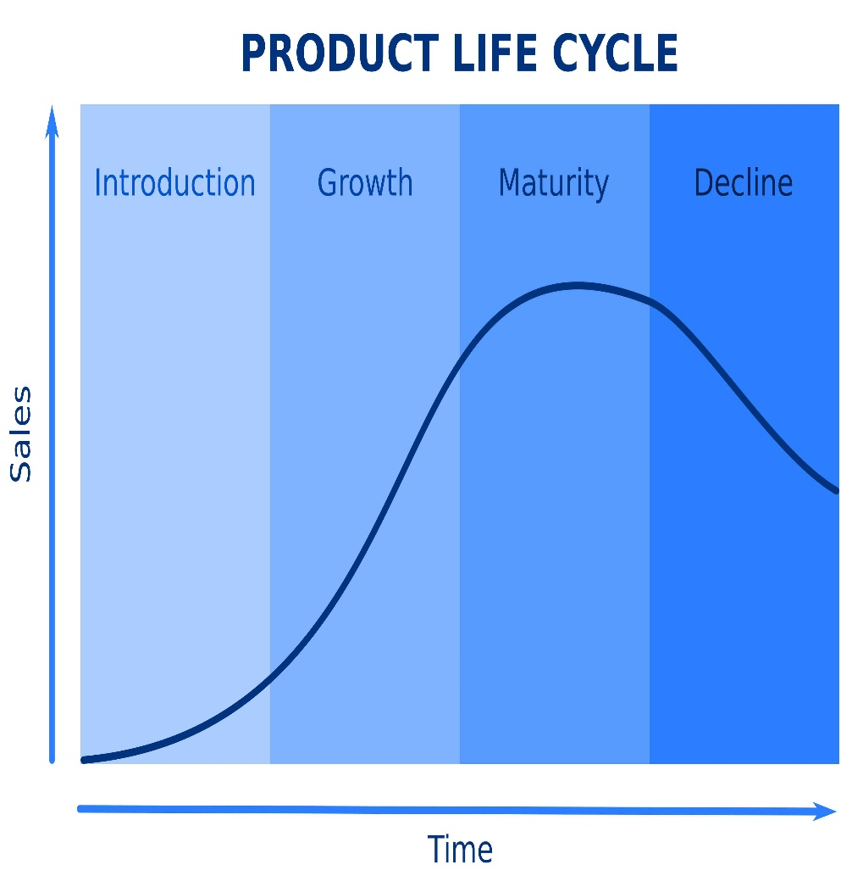
Product Life Cycle
Growth
Maturity
Heavy Promotion
The platform experiences rapid user acquisition & market share growth
Audience Preferred content
Growth slows down as competition interferes
Disney + Hot star continues to innovate and offer new features

Slide 16
New Product Development
Interactive content: Offer choose-your-own-adventure style shows for children or interactive quizzes and polls related to shows.
Special subscription tiers: Offer mobile-only plans at lower prices to attract budget-conscious users and increase accessibility in developing markets.
Offline viewing improvements: Allow users to download content in higher quality or for longer durations.

Slide 17
THANK
YOU

